Slide 1
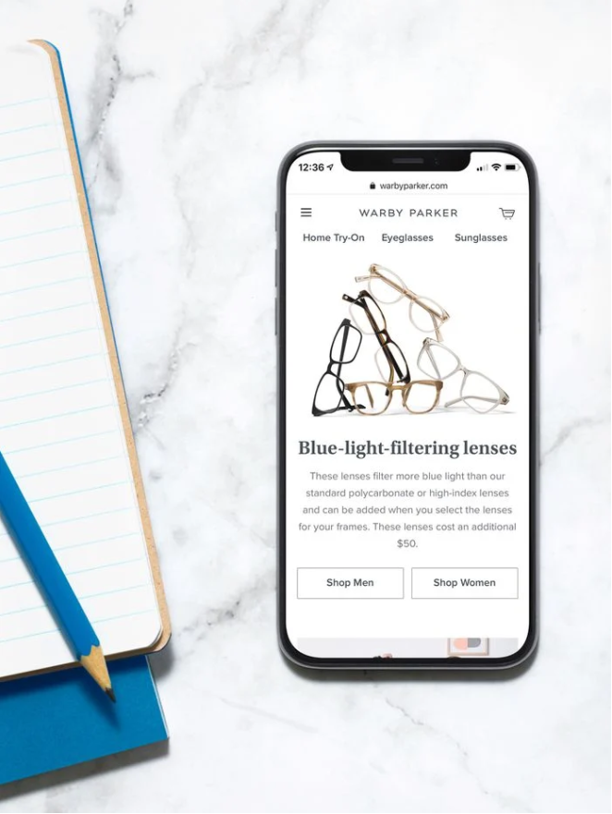

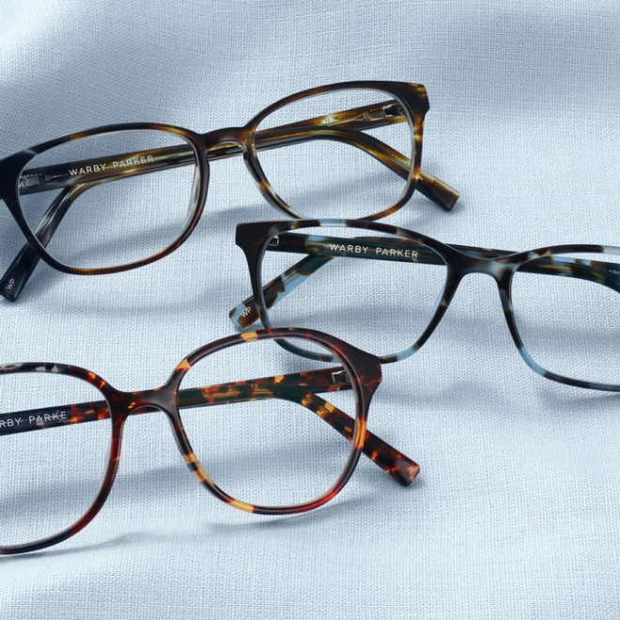
WARBY
PARKER
Usage Funnels
Sampath Gonnuru | 04.20.2020

Slide 2

About
Warby Parker is a transformative lifestyle brand with a lofty objective: to offer designer eyewear at a revolutionary price while leading the way for socially conscious businesses. Founded in 2010 and named after two characters in an early Jack Kerouac journal, Warby Parker believes in creative thinking, smart design, and doing good in the world. For every pair of eyeglasses and sunglasses sold, a pair is distributed to someone in need.

Slide 3
1) Survey- Quiz Funnel
“What are you looking for?”
“What’s your fit?”
“Which shapes do you like?”
“Which colors do you like?”
“When was your last eye exam?”
The users’ responses are stored in a table called survey.
2) Take home & Try on
Number & Percentage of Users at each stage in the funnel
Number & Percentage of Users given 5 pairs of glasses & 3 pairs during trail + purchases
3) Style Quiz
Percentage of Users & Popularity of Styles and Fit
Percentage of Users & Popularity of Shape and Color
4) Purchases & Revenue
Total Purchases + Breakdown Per Style Type
Purchases broken down by color & model Incl. Prices – Sorted by Total Revenue
Purchases broken down by color & model Inc. Prices – sorted by Popularity
Purchases broken by model only Incl. Prices – Sorted by Total Revenue & Popularity
TABLE OF CONTENTS
SURVEY-QUIZ FUNNEL
TAKE-HOME & TRY ON FUNNEL
STYLE QUIZ
PURCHASES & REVENUE

Slide 4
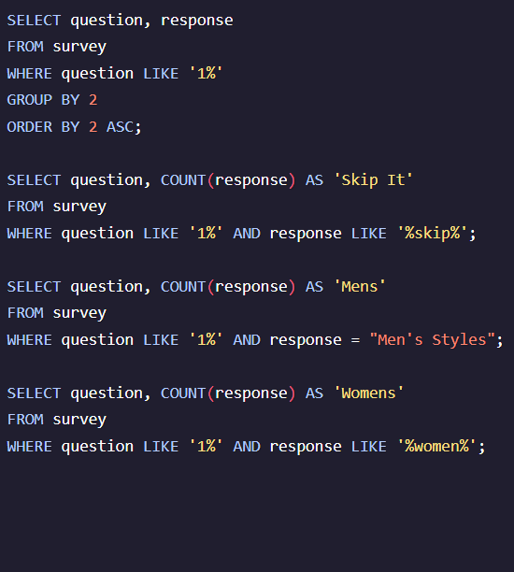
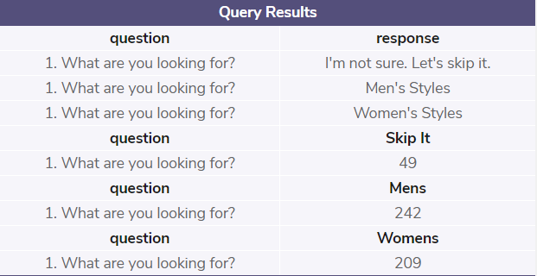
1.1 WHAT ARE YOU LOOKING FOR ?
Summary of Findings:
Total Users who took the survey were 500
Selection was evenly split between Men and Women,
Men’s style was 48.40%, Women’s style was 41.80%
~ 10 % of users didn’t specify

Slide 5
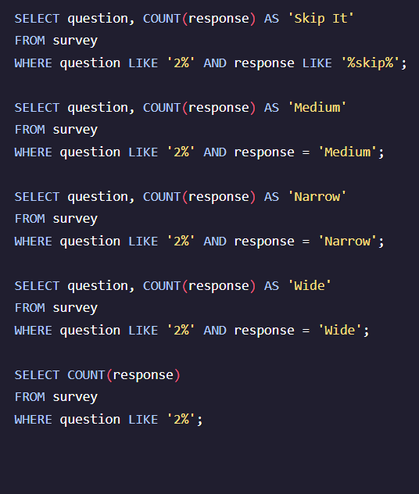
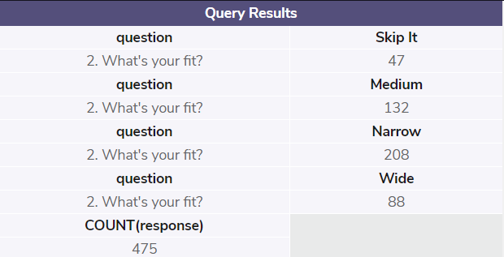
1.2 WHAT’s YOUR FIT?
Summary of Findings:
Most Popular Fit selected was ‘Narrow’
Close to 30% users selected Medium
The Least Fit selection was ‘Wide’ at 20%
~ 10 % of users have skipped the question

Slide 6
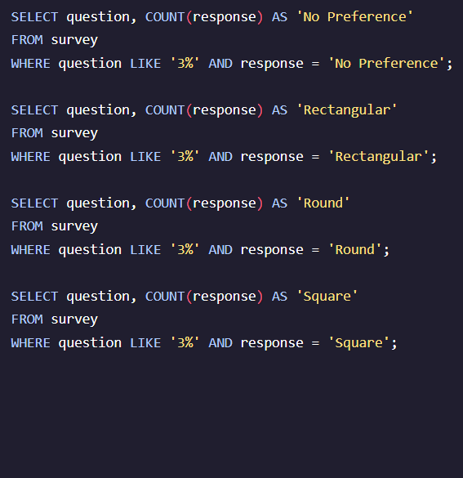
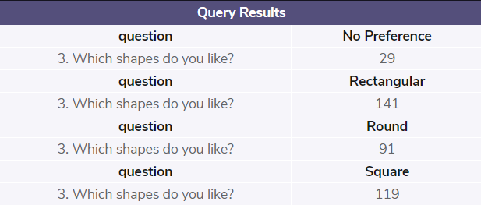
1.3 WHICH SHAPES DO YOU LIKE?
Summary of Findings:
Most Popular Shape selected was ‘Rectangular’ at 37%
Close to 31% users selected ‘Square’
Third was ‘Round’ at 20%
~ 8 % of users didn’t specify a preference

Slide 7
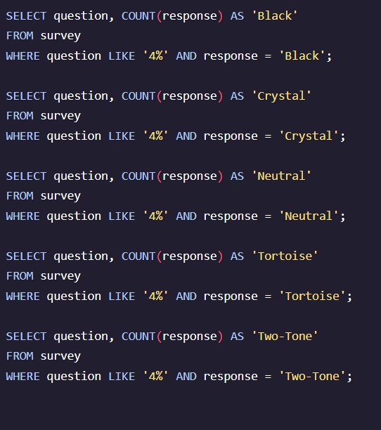
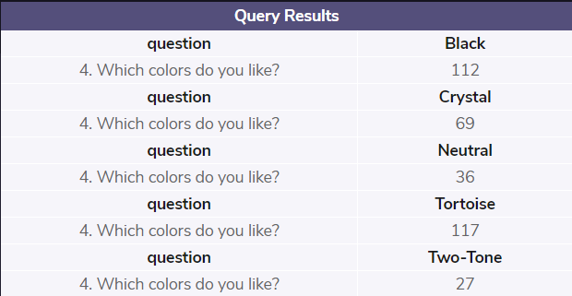
1.4 WHICH COLORS DO YOU LIKE?
Summary of Findings:
Almost 70% users preferred either ‘Black’ or ‘Tortoise’
Close to 20% users preferred Crystal
The Least preferred were Neutral and Two-Tone, with 10% and 8% respectively

Slide 8
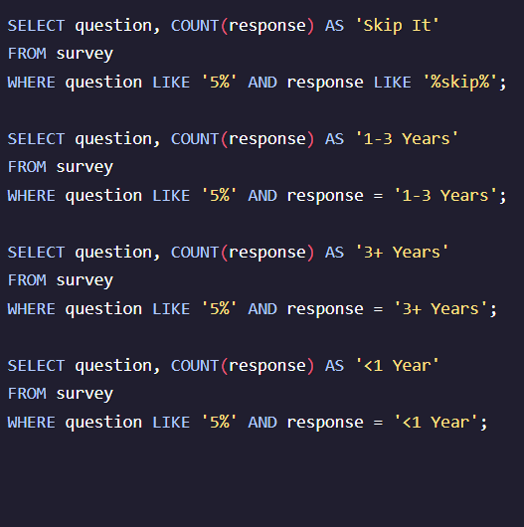
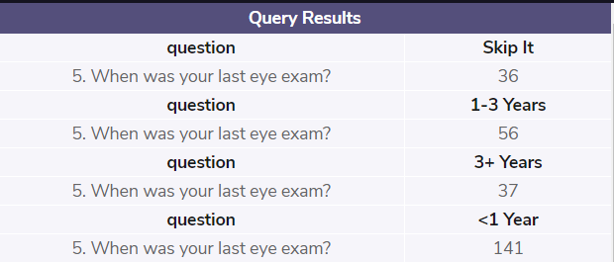
1.5 WHEN WAS YOUR LAST EYE EXAM?
Summary of Findings:
Around 50% of users who completed the survey had an eye exam less than a year ago
Close to 20% users had between 1-3 years ago
13.7% had over 3 years ago
~ 13.3 % of users have skipped the question

Slide 9
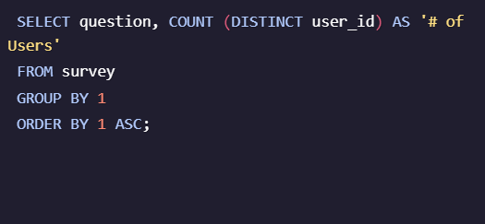
1.6 BREAKDOWN OF ALL QUESTIONS AT EACH STAGE
Summary of Findings:
95% of users move from ‘Sunglasses/Reading Glasses Select’ (Q1) to Fit (Q2)
From Fit (Q2) to Shape (Q3) we retain less users, 80%, which is a drop of 20%.
From Shape (Q3) to Color (Q4), we have a higher retention rate of 95%.
From Color (Q4) to Eye Exam (Q5), we have our most significant drop, retaining only ~75% of our previous users, which is a drop of ~25%.
Survey Questions | # of Users | % of Initial No. of Users At Each Stage | % of Completion at Each Stage | % of DIFFERENCE of Completion at Each Stage
1. What are you looking for? | 500 | 100.00% | 100.00% | 0.00%
2. What's your fit? | 475 | 95.00% | 95.00% | 5.00%
3. Which shapes do you like? | 380 | 76.00% | 80.00% | 20.00%
4. Which colors do you like? | 361 | 72.20% | 95.00% | 5.00%
5. When was your last eye exam? | 270 | 54.00% | 74.79% | 25.21%

Slide 10
SUMMARY & SUGGESTIONS
The drop from Q1 to Q2 is minimal, 5%. This might be expected as people may start the quiz to see what it’s about then exit due to lack of interest. The loss of users is slightly high from Fit (Q2) to Shape (Q3) which may be due to the user a) just not liking any of the available shapes, or b) again, lose interest in continuing the survey for whatever reason. We see from Q3 to Q4, that we retain almost all our previous users, suggesting that those users that find a shape they like, want to continue specifying their preferences, showing interest in Warby’s selection of glasses. However our last question about how long it’s been since their last eye exam, seems to put some people off. It could possibly be that they felt that that question was personal to the point of unnecessary, or that they assumed that the questions would continue after that stage, asking for more personal details, which they were not comfortable disclosing.
Our problem areas therefore seem to be the Shape of the glasses and the Eye Exam query. With regards to the shape, we could possibly consider a selection of a larger variety of shapes which include ‘style’ such as ‘cat-eye’, ‘aviator’ or 70s or 80s.
With regards to Question 5 about the Eye Exam, my suggestion would be to remove it or at least conduct an A/B test where this question is removed to confirm if there would be an increase in the completion rate. It may be more pertinent to ask this question once they have selected their glasses and are in the process of completing their order. Another alternative or addition could be to explain why the question is being asked - whether it’s asked during the quiz or with the order. This may help encourage not only an answer, but an honest answer from the users, who otherwise, particularly at the quiz stage, may be clicking on a random answer just to finish the quiz, despite the option to skip the question.

Slide 11
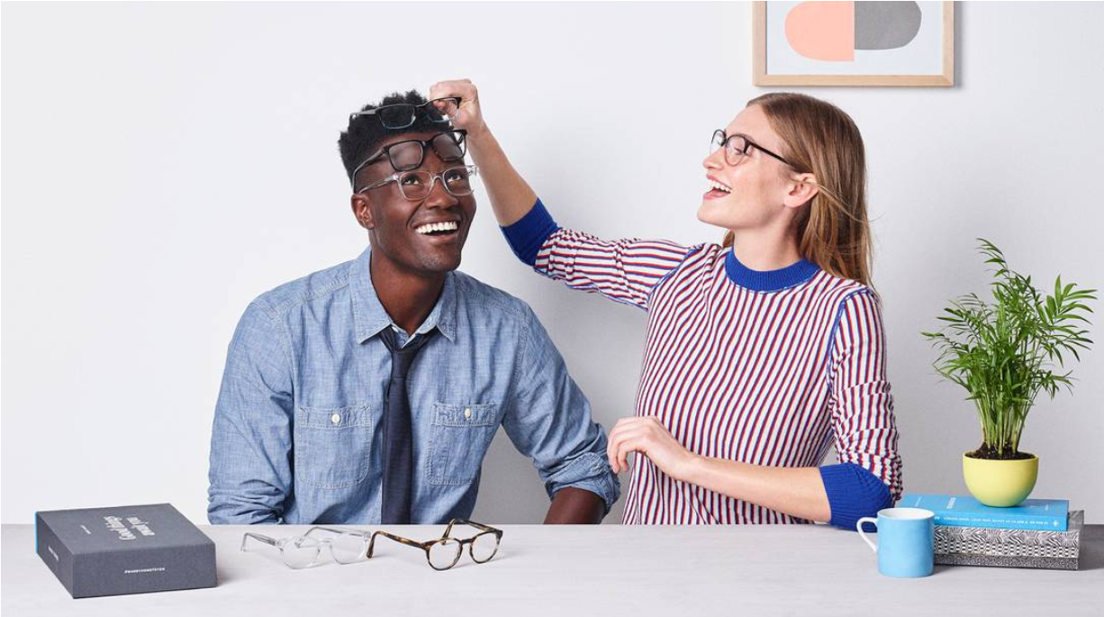
TAKE HOME& TRY ON

Slide 12
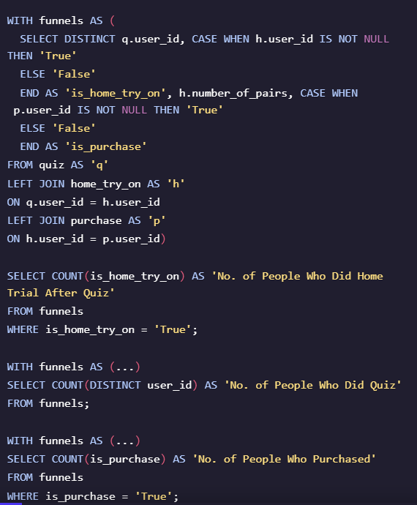
2.1 NUMBER & PERCENTAGE OF USERS AT EACH STAGE
Summary of Findings:
Out of the 1000 users who completed the Quiz, approximately half purchased and half didn’t.
After completing the quiz, 75% opted for the Home trial, whilst 66% of those who did the trial ended up purchasing glasses.
Alternatively, 25% of those that did complete the quiz did not do the trial, and 34% that did do the trial didn’t purchase.
 |  | % of Total People Who Did Quiz | % of People at Each Stage of Funnel | % of Difference at Each Stage of Funnel
No. of People Who Did Quiz | 1000 | 100.00% | 100.00% | 0.00%
No. of People Who Did Home Trial After Quiz | 750 | 75.00% | 75.00% | 25.00%
No. of People Who Purchased | 495 | 49.50% | 66.00% | 34.00%
No. of People Who DID NOT Purchase | 505 | 50.50%

Slide 13
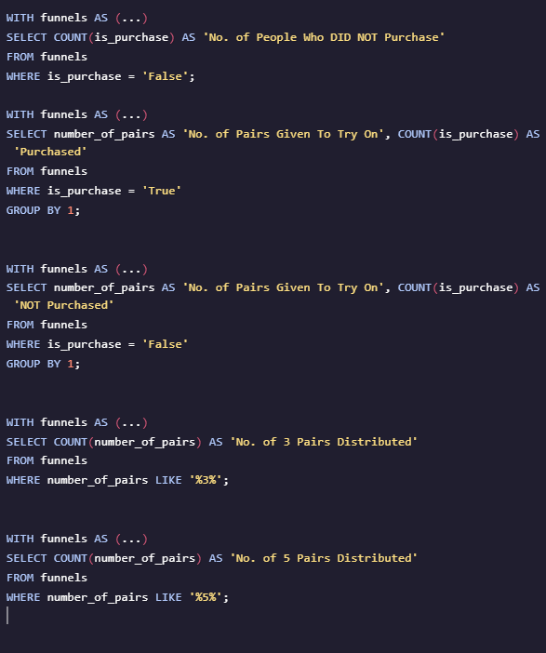
2.2 GIVEN 5 PAIRS & 3 PAIRS DURING THE TRIAL + PURCHASES
Summary of Findings:
‘Home & Try On’ Trial, approximately 53% users opted for free trial were given 3 pairs of glasses to try, whilst others were given 5 pairs to try.
A total of 66% that did the Home & Try On Trial actually purchased glasses.
Out of the users that received 3 pairs glasses, ~53% purchased glasses, and out of the users that received 5 pairs glasses, ~79% purchased.
The difference between receiving 5 pairs and 3 pairs is significant, as the data shows that users are 26% more likely to purchase by receiving 5 pairs of glasses to try instead of 3.
No. of 3 Pairs Distributed | No. of 5 Pairs Distributed | Total Distributed For Free Home Trial
379 | 371 | 750
No. of Pairs Given To Try On | Purchased | % Who Purchased
3 pairs | 201 | 53.03%
5 pairs | 294 | 79.25%
Total Purchased | 495 | 66.00%
Difference Between 3 Pairs & 5 Pairs | 26.21%

Slide 14
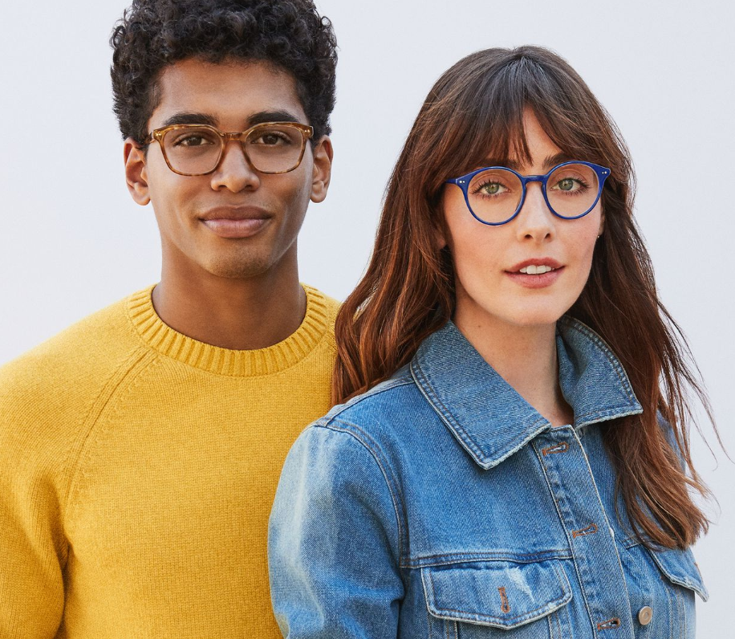
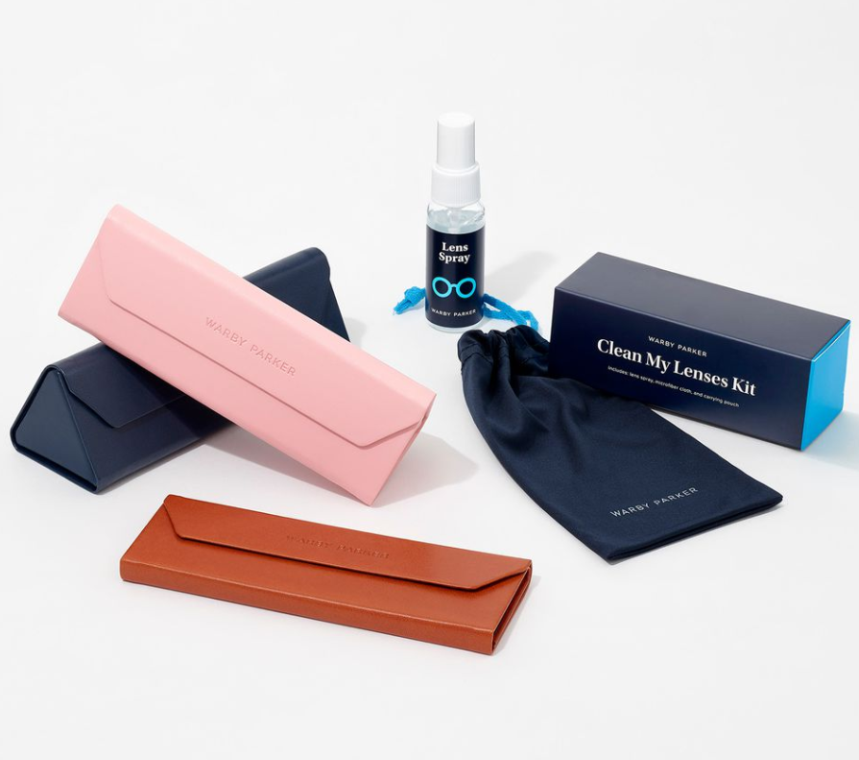
STYLES
QUIZ

Slide 15
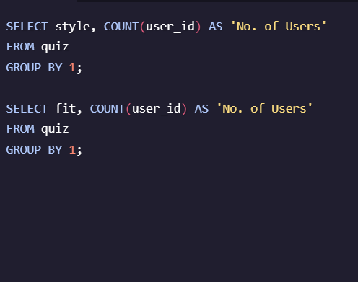
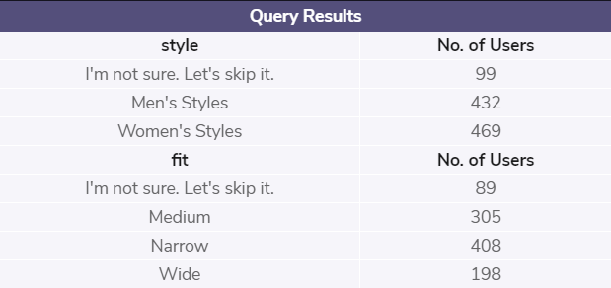
3.1 PERCENTAGES OF USERS & POPULARITY OF STYLES AND FIT
Summary of Findings:
Most Popular Fit selected was ‘Narrow’
Close to 30% users selected Medium
The Least Fit selection was ‘Wide’ at 20%
~ 10 % of users have skipped the question

Slide 16
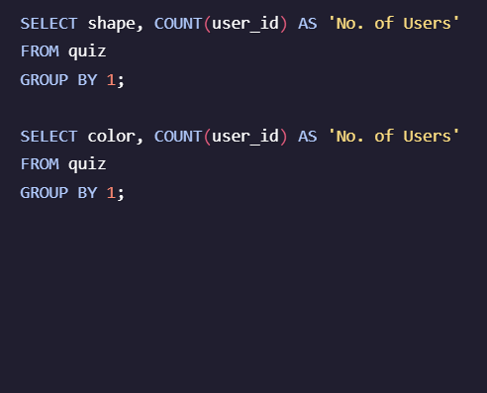
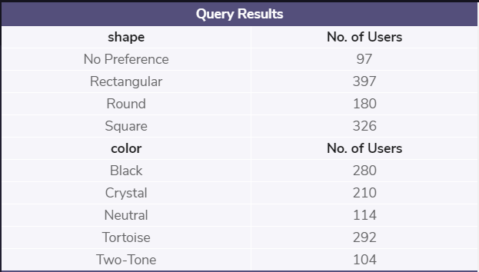
3.2 PERCENTAGE OF USERS & POPULARITY OF SHAPE AND COLOR
Summary of Findings:
Most Popular Fit selected was ‘Narrow’
Close to 30% users selected Medium
The Least Fit selection was ‘Wide’ at 20%
~ 10 % of users have skipped the question

Slide 17

PURCHASE & REVENUE

Slide 18
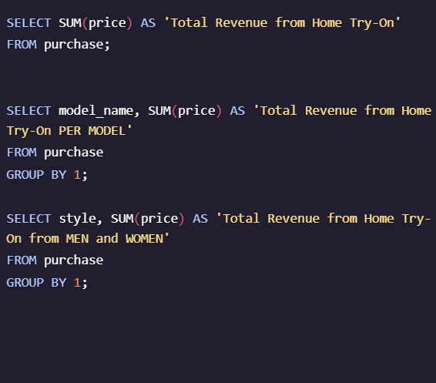
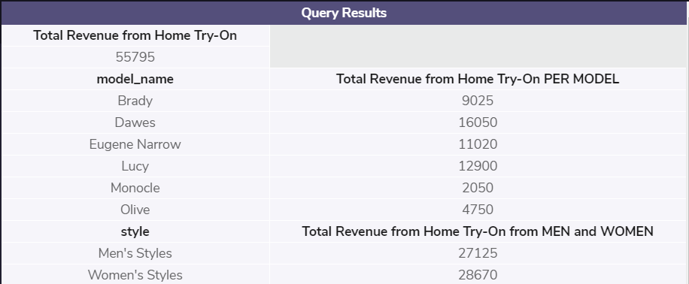
4.1 TOTAL PURCHASES + BREAKDOWN PER STYLE TYPE

Slide 19
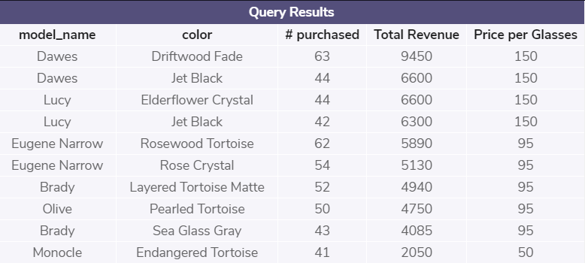
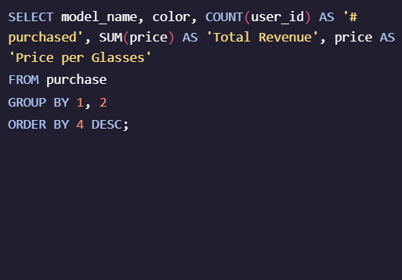
4.2 PURCHASES BROKEN DOWN BY COLOR & MODEL SORTED BY TOTAL REVENUE

Slide 20
4.3 PURCHASES BROKEN DOWN BY COLOR & MODEL SORTED BY POPULARITY
Popularity | model_name | color | # purchased | Price per Pair
1st | Dawes | Driftwood Fade | 63 | 150
2nd | Eugene Narrow | Rosewood Tortoise | 62 | 95
3rd | Eugene Narrow | Rose Crystal | 54 | 95
4th | Brady | Layered Tortoise Matte | 52 | 95
5th | Olive | Pearled Tortoise | 50 | 95
6th | Dawes | Jet Black | 44 | 150
7th | Lucy | Elderflower Crystal | 44 | 150
8th | Brady | Sea Glass Gray | 43 | 95
9th | Lucy | Jet Black | 42 | 150
10th | Monocle | Endangered Tortoise | 41 | 50

Slide 21
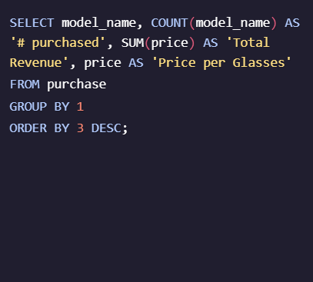
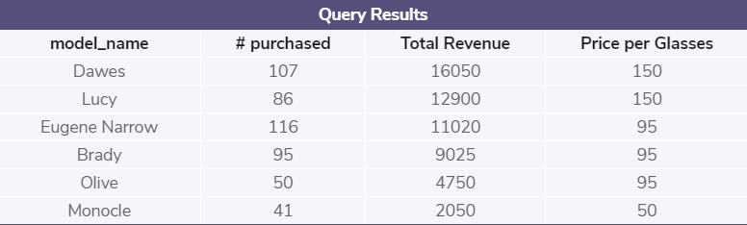
4.4 PURCHASES BROKEN DOWN BY MODEL ONLY SORTED BY TOTAL REVENUE & POPULARITY

Slide 22
4 SUMMARY
Summary of Findings:
The total revenue generated from the Take Home and Try On Trial amounted to $55,795.00.
Revenue was generated from Men’s glasses was almost equal to the revenue generated from Women’s glasses.
Collectively, Dawes glasses generated ~$16,000 in revenue (almost 30% of total revenue), whilst Lucy and Eugene Narrow each brought in $12,900 (23%) and ~$11,000 (20%) respectively. Brady brought in ~$9000 (16%). The last two models brought in the least revenue, Olive ~$4,700 (8.5%) and Monocle ~$2,000 (3.6%).
Despite being one of the more expensive model, Dawes was the 2nd most popular model purchased, Eugene Narrow being the 1st. Brady and Lucy come in 3rd and 4th respectively, both significantly popular as well, again, even though Lucy is one of the more expensive models. Subsequently, Lucy and Dawes were the highest earners.

